Slide 1
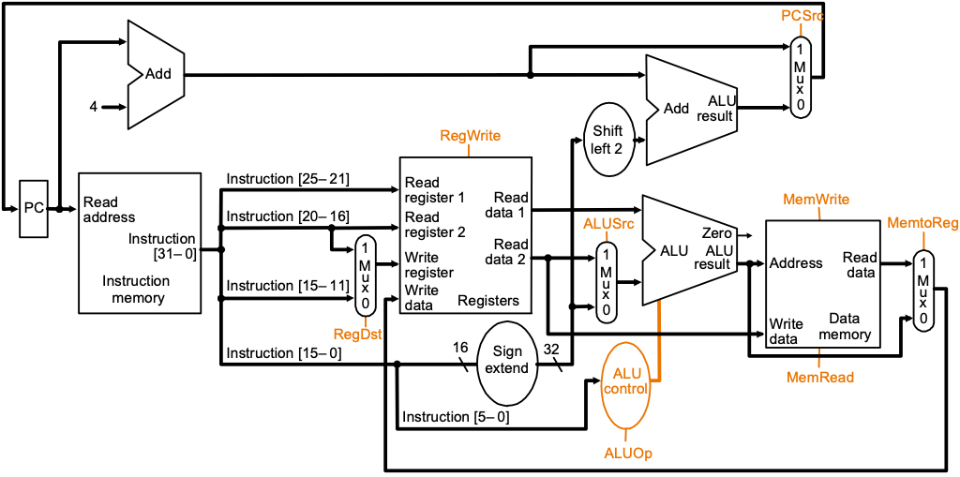
R-type Instructions – ADD Instruction
rs
rt
rd
ALU-Type
(ADD R3, R2, R1)
IF
ID/RF
EX
WB to Reg.
if MEM[PC] == ADD rd rs rt
GPR[rd] ← GPR[rs] + GPR[rt]
PC ← PC + 4
0
6-bit
rs
5-bit
rt
5-bit
rd
5-bit
0
5-bit
ADD
6-bit
ADD rd, rs, rt

Slide 2
I-type Instructions - ADDI Instruction
rs
rt
rd
ALU-Type
(ADD R3, R2, R1)
IF
ID/RF
EX
WB to Reg.
if MEM[PC] == ADDI rt rs immediate
GPR[rt] ← GPR[rs] + sign-extend (imm)
PC ← PC + 4
ADDI
6-bit
rs
5-bit
rt
5-bit
immediate
16-bit
ADDI rt, rs, immediate

Slide 3
I-type Instructions - LW Instruction
rs
rt
rd
LW
(LW R2, 4(R1))
IF
ID/RF
EX
MEM
WB to Reg.
if MEM[PC]==LW rt offset₁₆ (base)
Addr = sign-extend(offset) + GPR[base]
GPR[rt] ← MEM[Addr]
PC ← PC + 4
LW
6-bit
rs
5-bit
rt
5-bit
offset
16-bit
LW rt, offset(rs)

Slide 4
I-type Instructions - SW Instruction
rs
rt
rd
SW
(SW R2, 8(R1))
IF
ID/RF
EX
MEM
if MEM[PC]==SW rt offset₁₆ (base)
Addr = sign-extend(offset) + GPR[base]
MEM[Addr] ← GPR[rt]
PC ← PC + 4
SW
6-bit
rs
5-bit
rt
5-bit
offset
16-bit
SW rt, offset(rs)

Slide 5
I-type Instructions - Branch Instructions
rs
rt
rd
BEQ
(BEQ R3, R1, displace)
IF
ID/RF
EX(compare)
Potentially Update PC = PC+disp
if MEM[PC]==BEQ rs rt immediate₁₆
target = PC + 4 + sign-extend(immediate) x 4
if (GPR[rs]==GPR[rt]) PC ← target
else PC ← PC + 4
BEQ
6-bit
rs
5-bit
rt
5-bit
immediate
16-bit
BEQ rs, rt, immediate

Slide 6
J-type Instructions - Jump Instructions
J
(J displace)
IF
ID/RF
Update PC = PC+disp+00
if MEM[PC]==J immediate₂₆
target = { PC[31:28], immediate₂₆, 2’b00 }
PC ← target
J
6-bit
immediate
26-bit
J immediate

